Slide 1
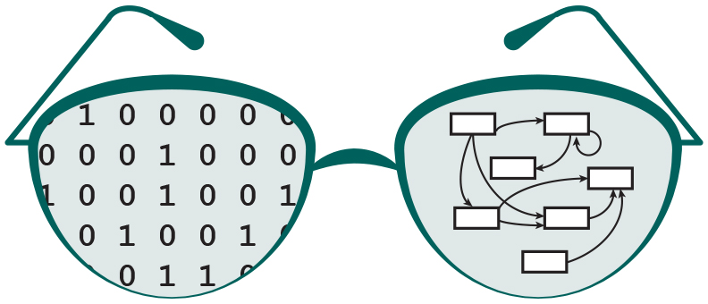

GRNsight v2: a web application for visualizing models of gene regulatory networks
Eileen J. Choe
Department of Electrical Engineering and Computer Science
Loyola Marymount University
Saturday, November 18, 2017
SCCUR Conference

Slide 2
Outline
Gene regulatory networks (GRNs) consist of genes, transcription factors, and the regulatory relationships between them.
GRNsight is an open source web application and service for visualizing models of gene regulatory networks.
In GRNsight version 2.0, the visual and analytic features were improved.
In GRNsight version 2.0, client and server side tests were expanded.

Slide 3
Outline
Gene regulatory networks (GRNs) consist of genes, transcription factors, and the regulatory relationships between them.
GRNsight is an open source web application and service for visualizing models of gene regulatory networks.
In GRNsight version 2.0, the visual and analytic features were improved.
In GRNsight version 2.0, client and server side tests were expanded.

Slide 4
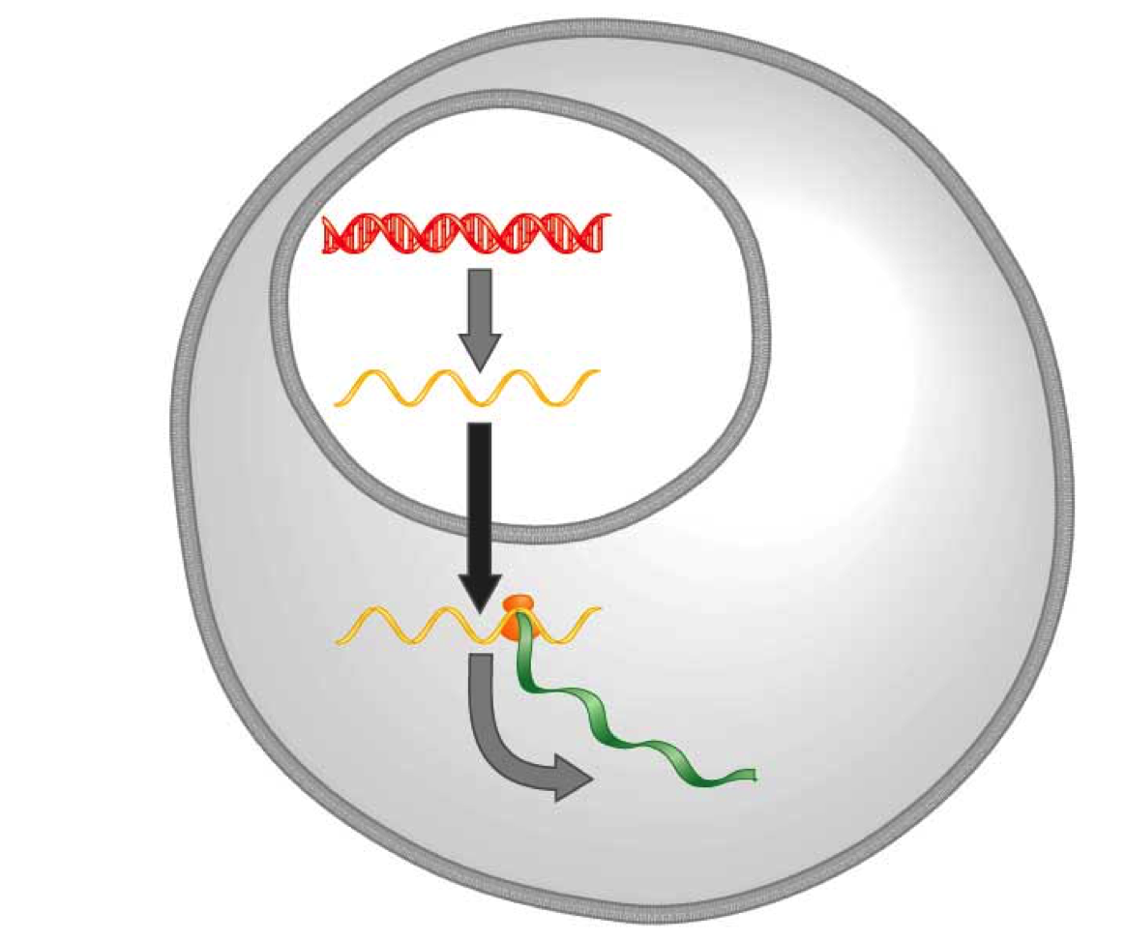
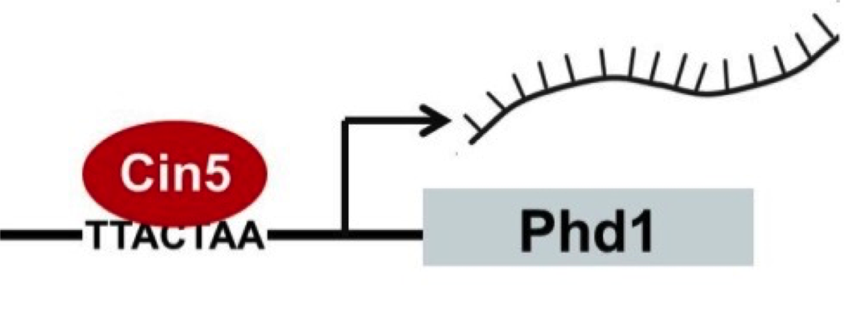
A gene regulatory network (GRN) controls the level of expression of genes and proteins
Transcription factors activate or repress expression.
To understand GRNs we want to quantify the weight values of these regulatory relationships
DNA
Transcription
mRNA
Translation
Protein
Gene regulatory process
Notes:
A GRN’s mechanism of control is transcription factors…

Slide 5
GRNmap models the dynamics of GRNs to estimate weight parameters (w)
Magnitude of weights represent the influence of the transcription factor on its target gene
Positive weights = activation of gene expression.
Negative weights = repression of gene expression.
GRNmap differential equation
Notes:
Weights represent the magnitude and sign of regulatory relationships.
Positive weights mean activation of gene expression.
Negative weights mean repression of gene expression.

Slide 6
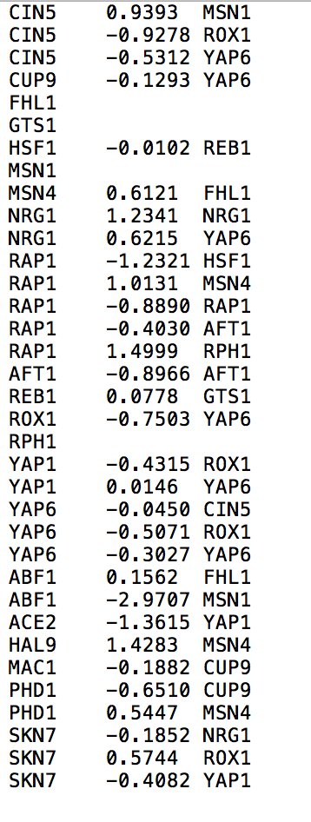
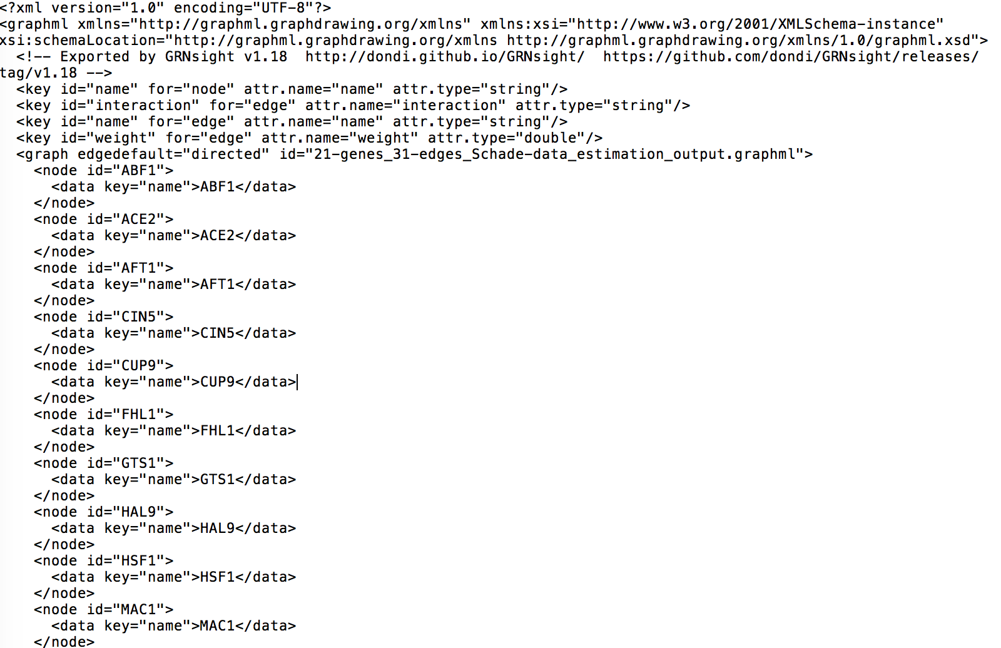
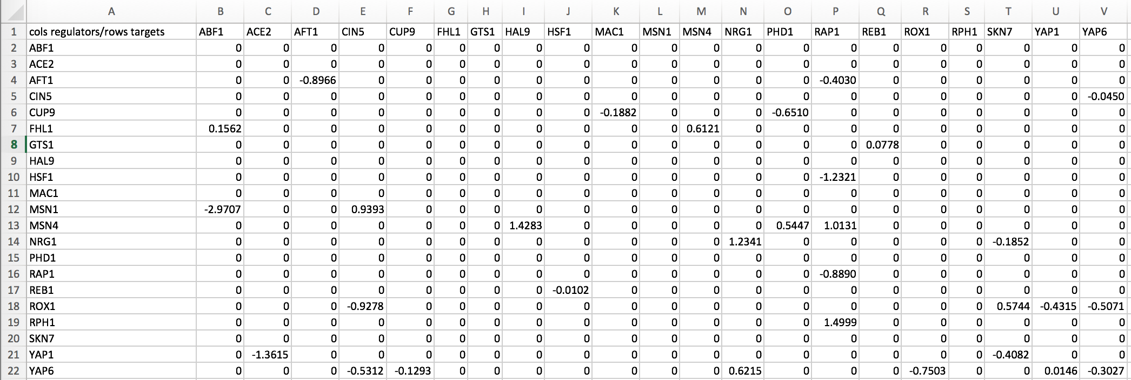
GRNmap outputs Excel spreadsheets, with estimated weight parameters
.xlsx
.graphml
.sif
21 gene, 31 edge weighted network output from GRNmap
Notes:
But it can also be represented in these other two file format (layer on the .sif and .graphml screenshots)

Slide 7
Outline
Gene regulatory networks (GRNs) consist of genes, transcription factors, and the regulatory relationships between them.
GRNsight is an open source web application and service for visualizing models of gene regulatory networks.
In GRNsight version 2.0, the visual and analytic features were improved.
In GRNsight version 2.0, client and server side tests were expanded.

Slide 8
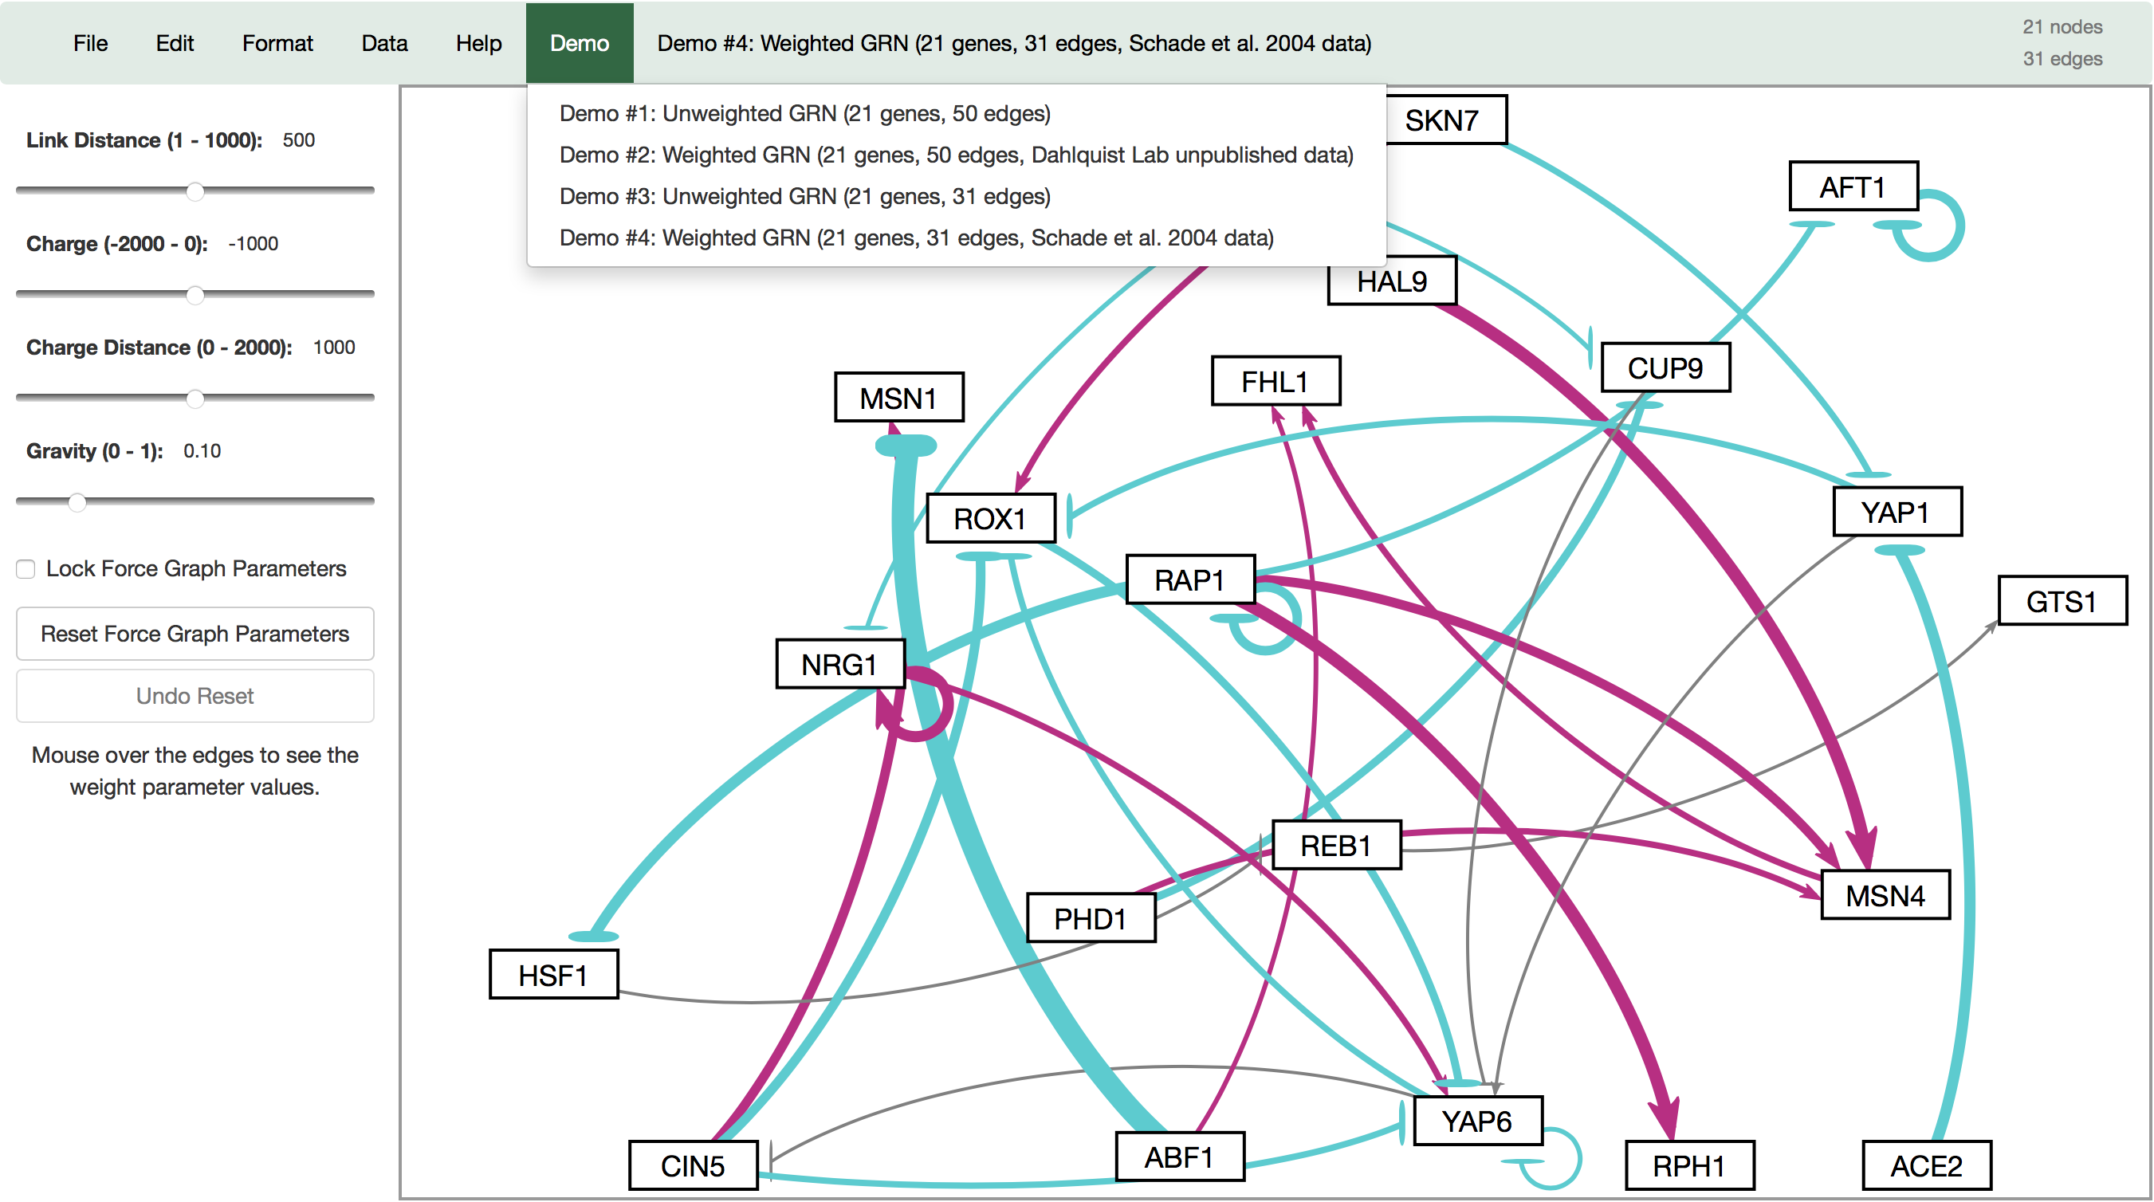
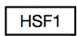
GRNsight automatically produces visualizations of weighted networks from adjacency matrix inputs
Key:
gene
activation
repression
weak influence
Screenshot of GRNsight v1, released Aug 2016
Notes:
Our solution is GRNsight, a web application which automatically produces visualizations of weighted networks from adjacency matrix inputs.
In a GRNsight visualization, rectangular nodes represent genes, and the thickness of arrows represent the strength of regulatory relationships.
The interface on the left panel, allows the user to modify force graph parameters, which apply physics simulation to the graph.
From user feedback of GRNsight v1, our research objective was to expand GRNsight’s visual and analytic features.
In this talk I will focus on two features developed for GRNsight v2.

Slide 9
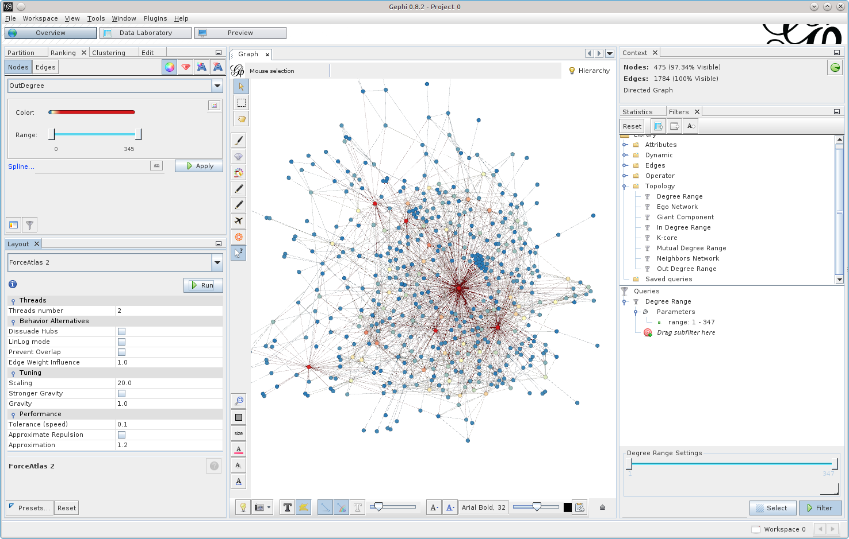
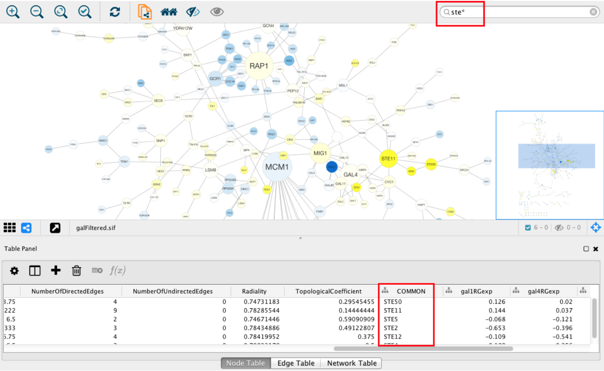
Existing visualization software must be installed and is optimized for large-scale graphs
Cytoscape – cytoscape.org
Gephi - gephi.org

Slide 10
GRNsight fills a niche in bioinformatics visualization software
Cytoscape and Gephi | GRNsight
Optimized for large-scale graphs. | Optimized for small- to medium- scale graphs.
Must be installed. | Exists as a web application.
Several complex features in addition to visualization. | Easy to use, and easily interpretable visualizations.

Slide 11
Outline
Gene regulatory networks (GRNs) consist of genes, transcription factors, and the regulatory relationships between them.
GRNsight is an open source web application and service for visualizing models of gene regulatory networks.
In GRNsight version 2.0, the visual and analytic features were improved.
In GRNsight version 2.0, client and server side tests were expanded.

Slide 12
A subset of visual and analytic features developed for GRNsight v2 is highlighted in this presentation
Corresponding Objectives:
Allow the graph to reach a steady state
Allow users to customize the normalization factor for edge thickness
Allow users to customize the gray edge threshold
Full list of v2 features documented in the release notes: http://dondi.github.io/GRNsight/about.html#releaseContent
Notes:
In this presentation, I will focus on a subset of these features developed for v2, which correcspond to the following three research objective.

Slide 13
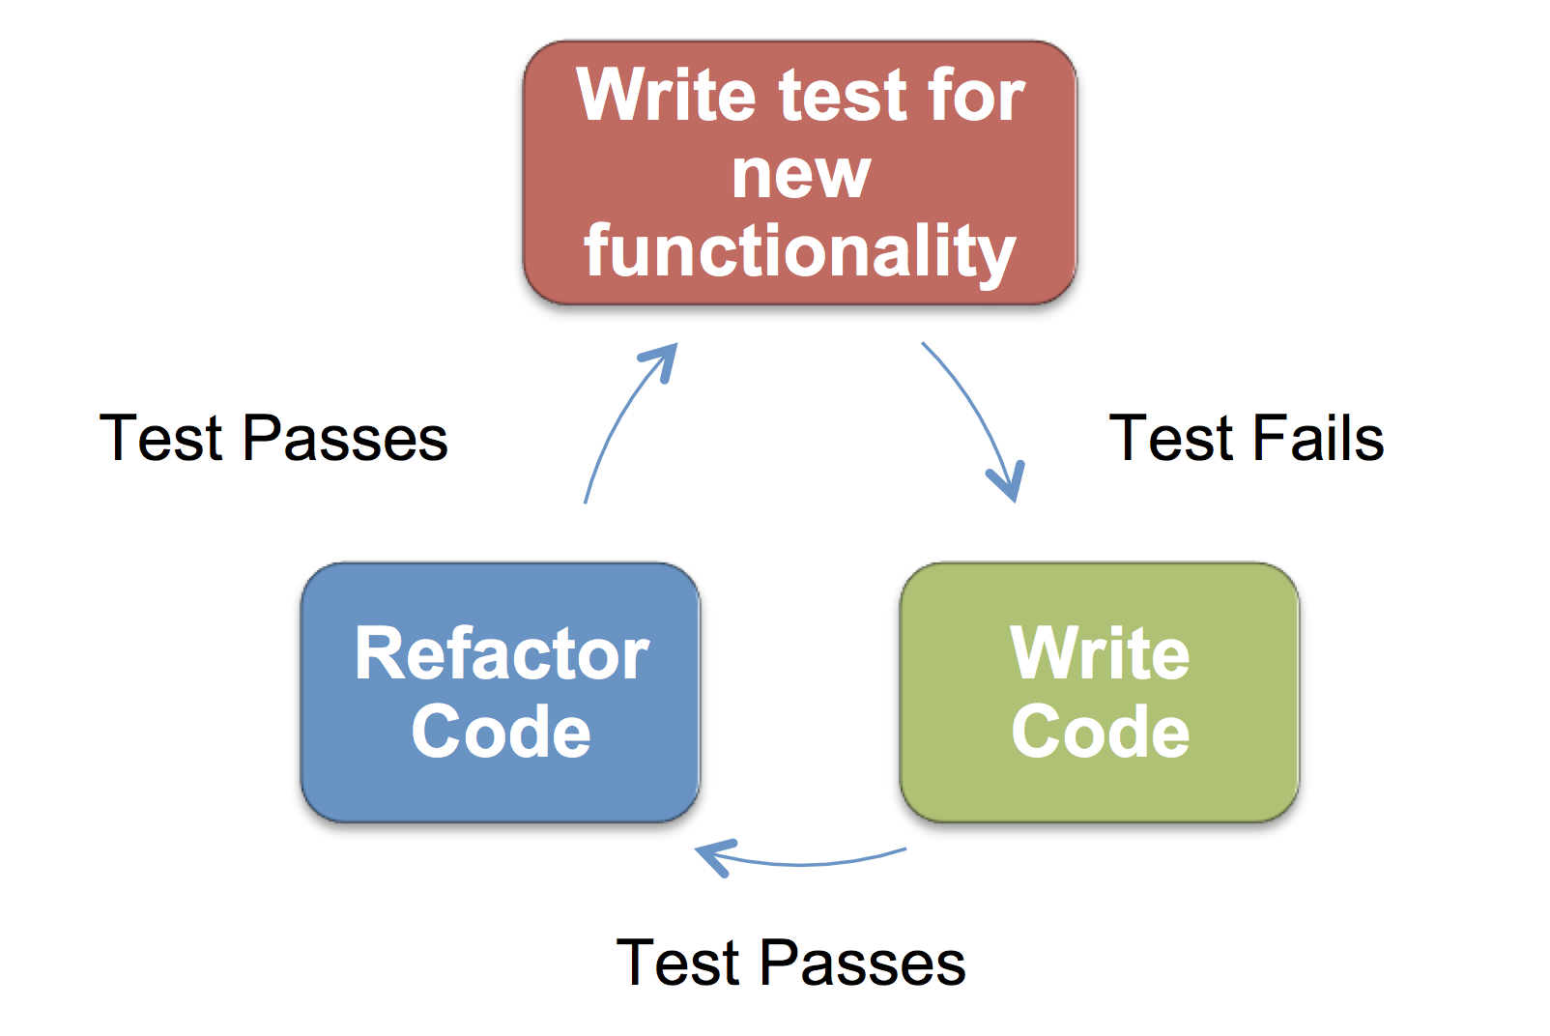



GRNsight is written in JavaScript and follows software engineering best practices
Test Passes
Test Fails
Test Passes
GRNsight technology stack
Test-driven development cycle
Notes:
Client, server, and tests written in the JavaScript programming language, assisted by the following libraries displayed on the left.
GRNsight follows the software engineering best practice of test driven development, in which tests are written for new functionality prior to the feature being developed.
-

Slide 14
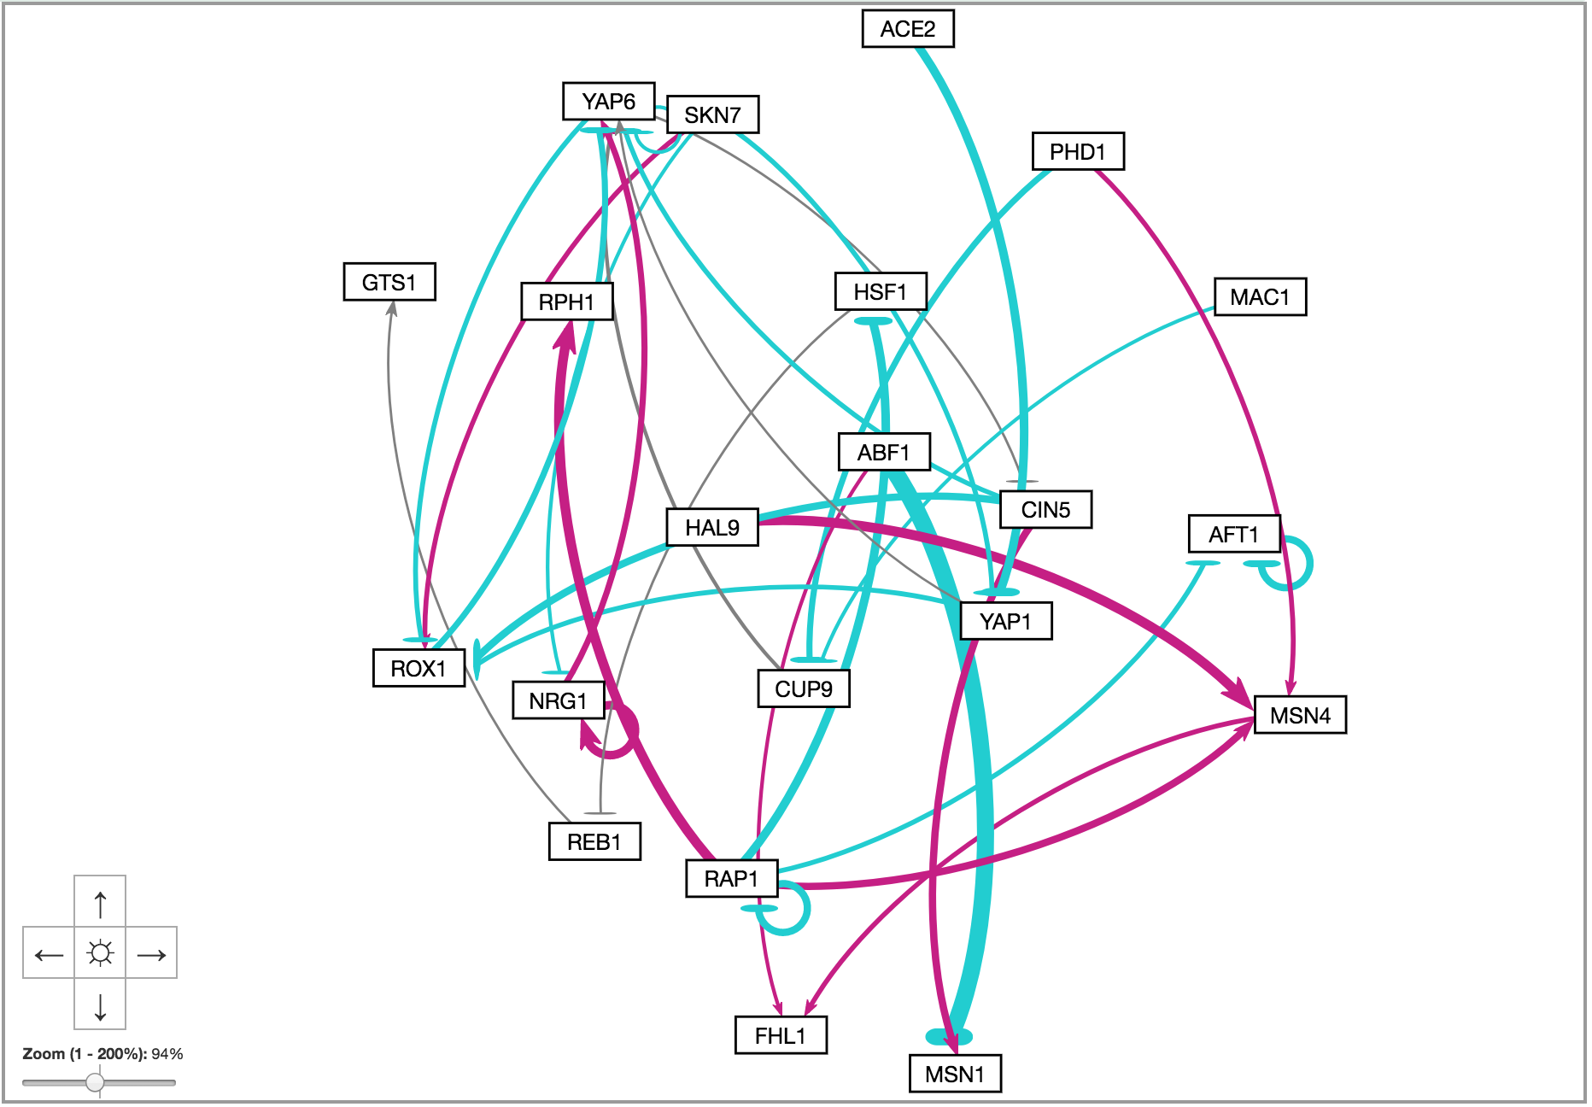
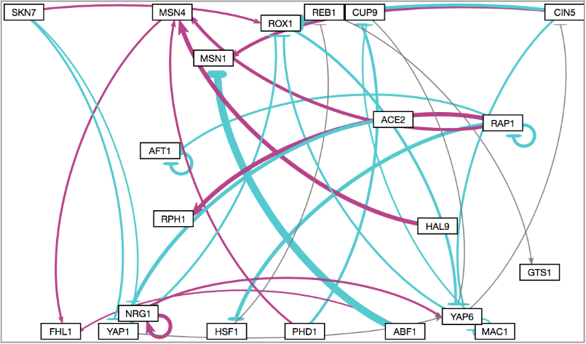
Allow the graph to reach a steady state
Objective #1
GRNsight v1
GRNsight v2
Nodes are restricted to the available screen area
No ability to zoom and scroll
Graph bounding box separated from viewport
Zoom and scrolling enabled
Notes:
Our first objective

Slide 15
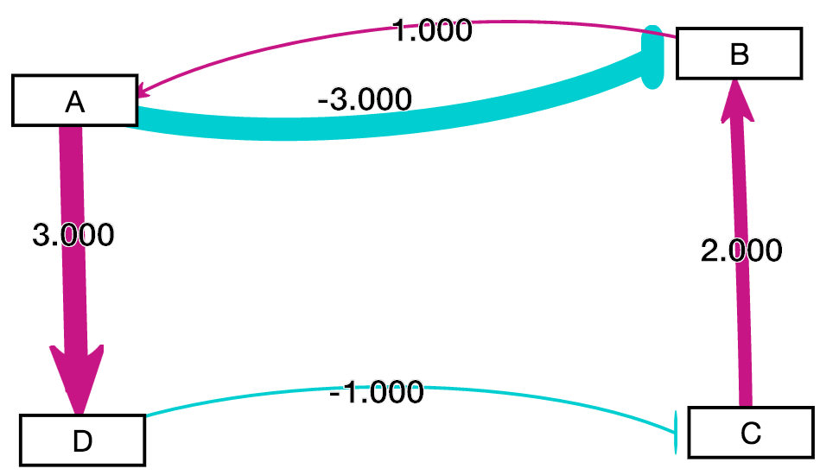
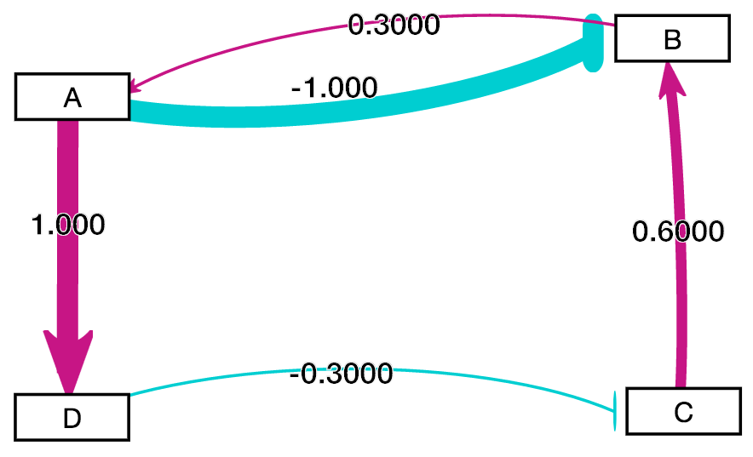
Allow users to customize normalization factor for edge thickness
Objective #2
GRNsight v1
Visually comparing two graphs was difficult.
Normalization factor was automatically set based on the maximum weight.
Circled edge thicknesses are the same although weight values are different
Notes:
Our second objective was to allow the user to customize the normalization factor for edge thickness.
The motivating problem in v1 was that visually comparing two graphs was difficult
For example, in the two graphs shown below, the circled edges with different weight values have the same thickness
This occurs because the normalization factor was automatically selected by maximum weight

Slide 16
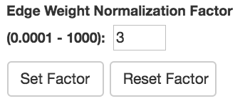
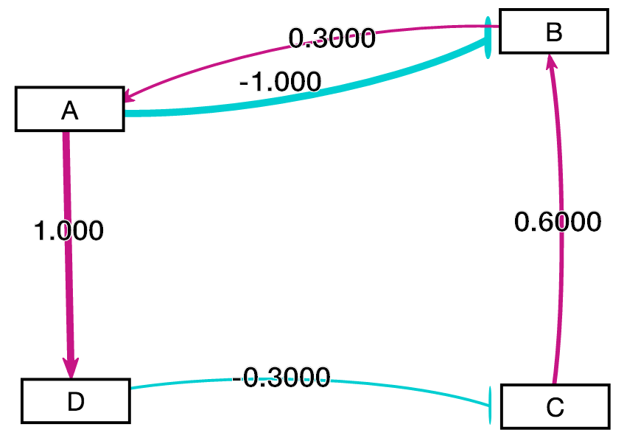
Allow users to customize normalization factor for edge thickness
Objective #2
GRNsight v2
Allows user to set normalization factor in user interface.
Edge thicknesses for different graphs can be rendered on the same scale.
Facilitates accurate visual comparison.
Normalization factor User Interface
Circled edge thicknesses are different when weight values are different
Notes:
We’ve solved this problem in GRNsight v2 by allowing users to set a custom normalization factor using the user interface screenshotted on the right
The two graphs are the same as those on the previous slide, except their edge thicknesses are now rendered on the same scale.
This facilitates accurate visual comparison

Slide 17
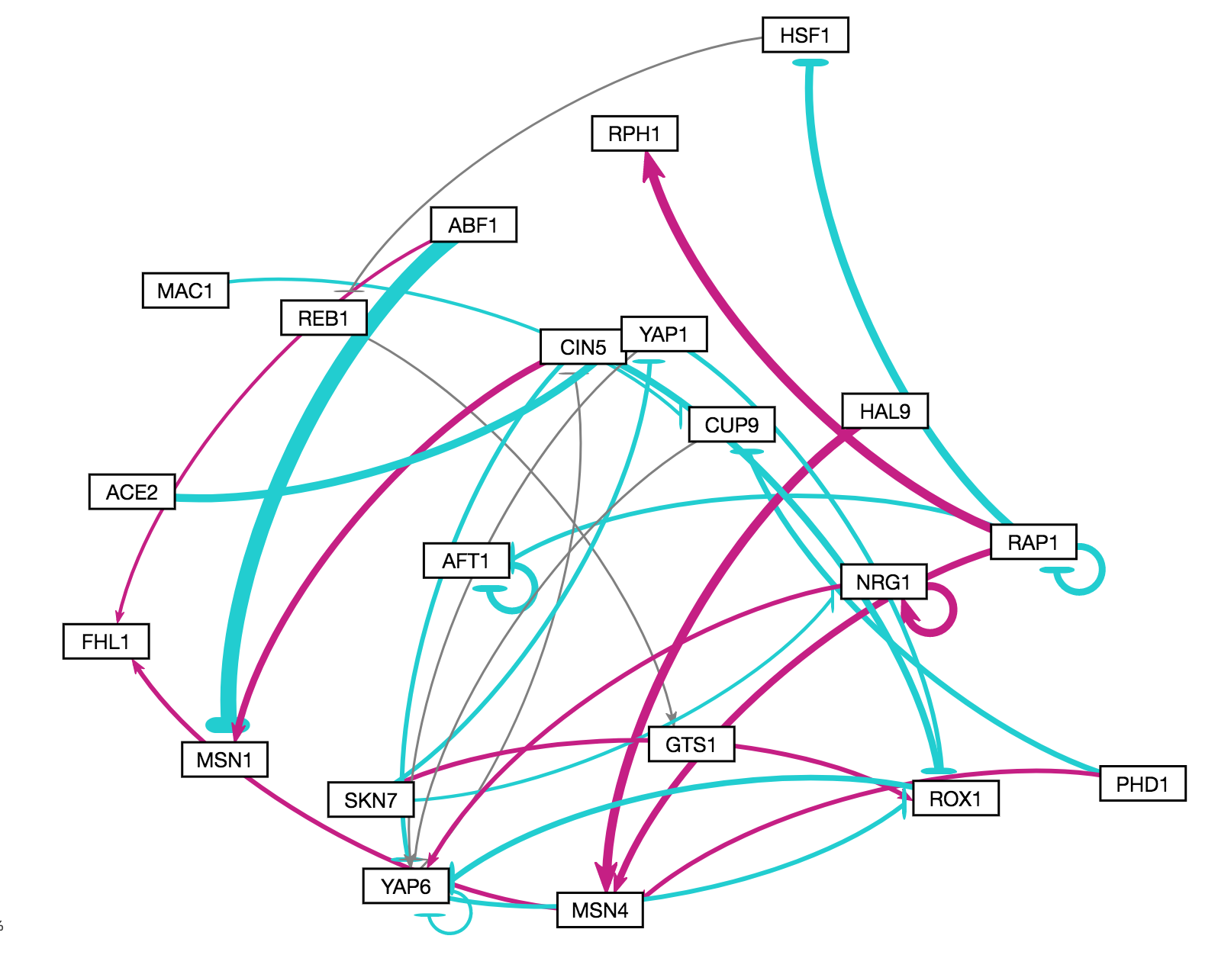
Allow users to customize gray edge threshold
Objective #3
GRNsight v1
Gray edges allow users to visually gauge whether a particular regulatory relationship is not important.
In v1, edges are colored gray if the magnitude of its value is <= 5% of the maximum edge weight value.
Notes:
We’ve solved this problem in GRNsight v2 by allowing users to set a custom normalization factor using the user interface screenshotted on the right
The two graphs are the same as those on the previous slide, except their edge thicknesses are now rendered on the same scale.
This facilitates accurate visual comparison

Slide 18
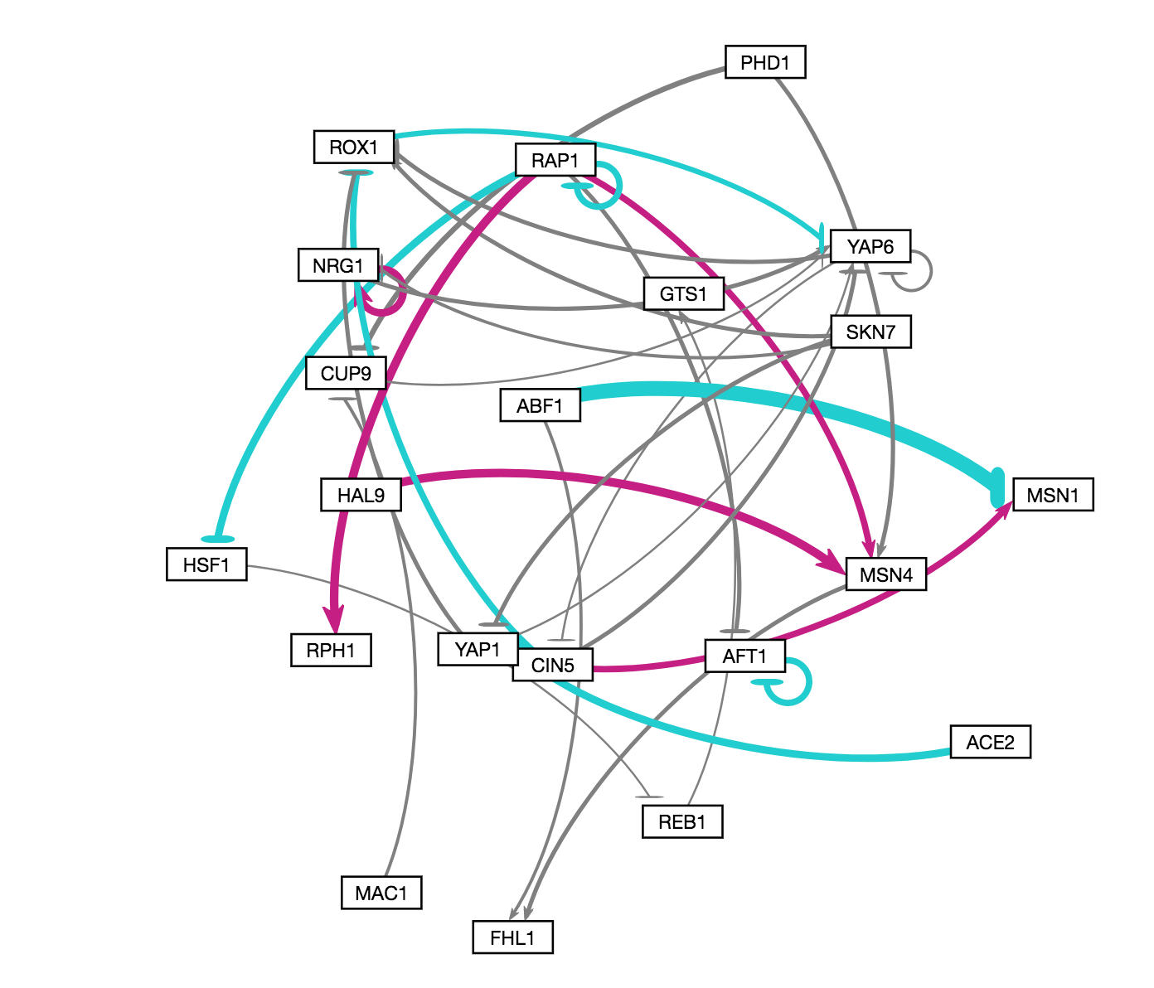
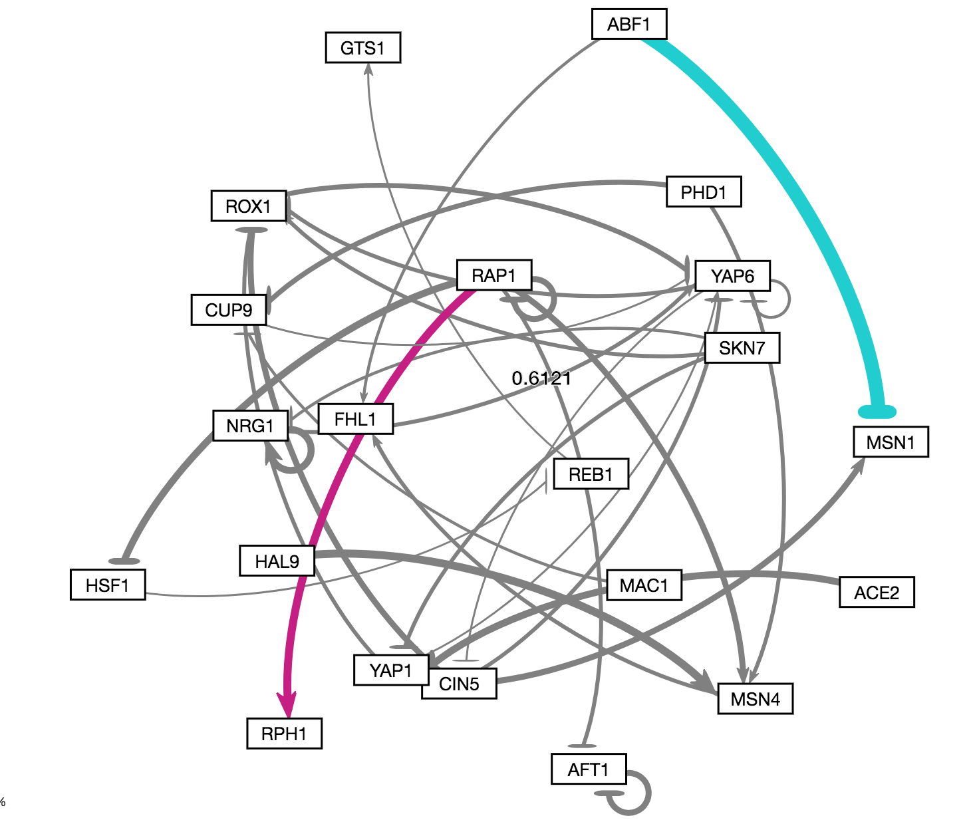
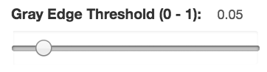
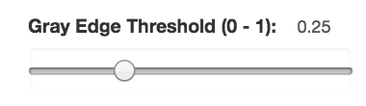

Allow users to customize gray edge threshold
Objective #3
GRNsight v2
Slider allows the gray edge threshold to be customized.
As the threshold value increases, only the highest magnitude regulatory relationships are rendered in color.
(default)

Slide 19
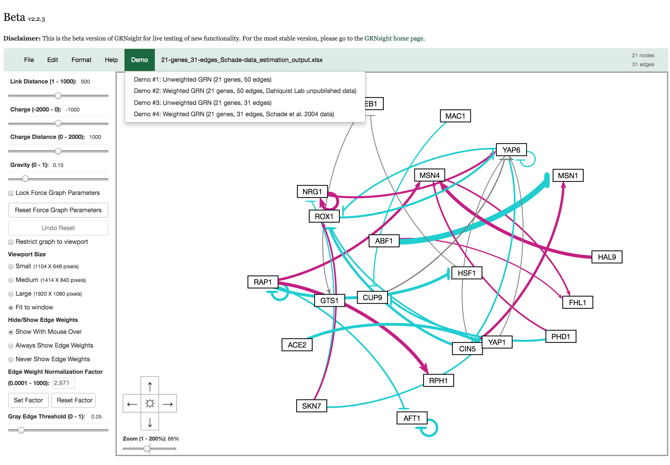
GRNsight v2.2.3 (beta) Screenshot
Allow graph to reach steady state
Allow users to customize normalization factor for edge thickness
Allow users to customize gray edge threshold
Notes:
In summary, the three visual and analytic features highlighted:

Slide 20
Outline
Gene regulatory networks (GRNs) consist of genes, transcription factors, and the regulatory relationships between them.
GRNsight is an open source web application and service for visualizing models of gene regulatory networks.
In GRNsight version 2.0, the visual and analytic features were improved.
In GRNsight version 2.0, client and server side tests were expanded.
Notes:
Now I’m going to talk about how we improved the client and server tests behind the scenes.

Slide 21
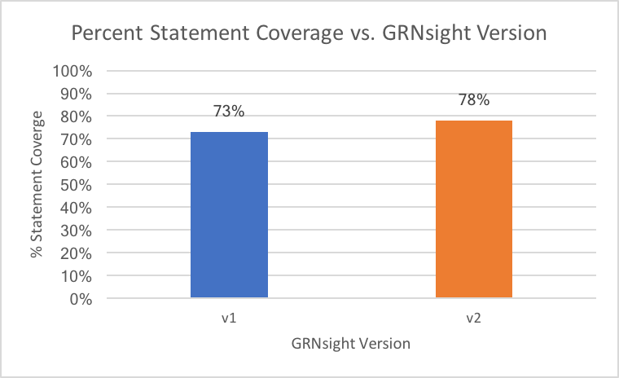
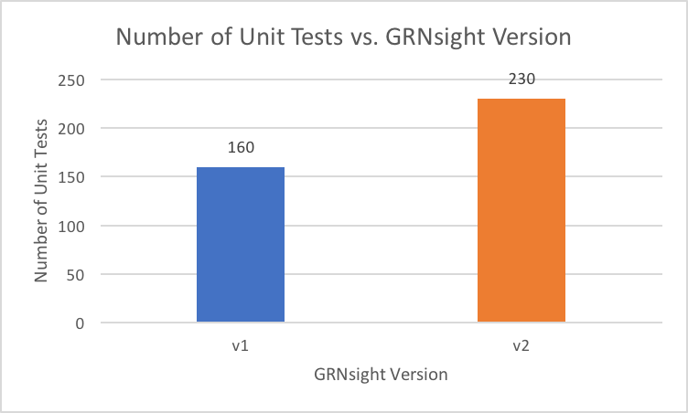
V2 increased our test coverage
43% increase in number of tests
5% increase in statement coverage

Slide 22
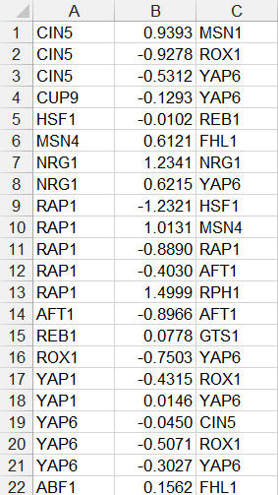
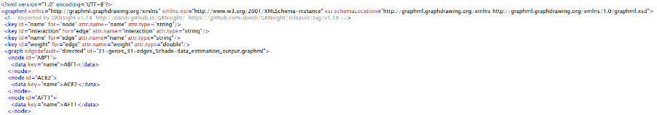
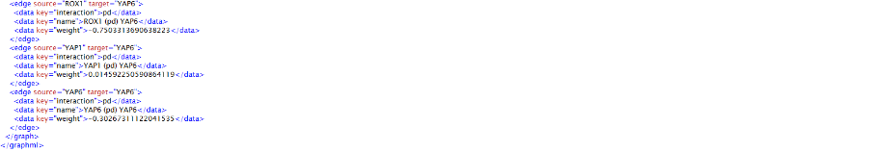
Server-side tests written for SIF and GraphML file types improves the quality of data interoperability
Tests for malformed Simple Interaction Format (.sif) and GraphML (.graphml) files were written, which report end user-targeted errors.
GraphML XML file with missing </data> tag
SIF file with missing target gene in cell C8

Slide 23
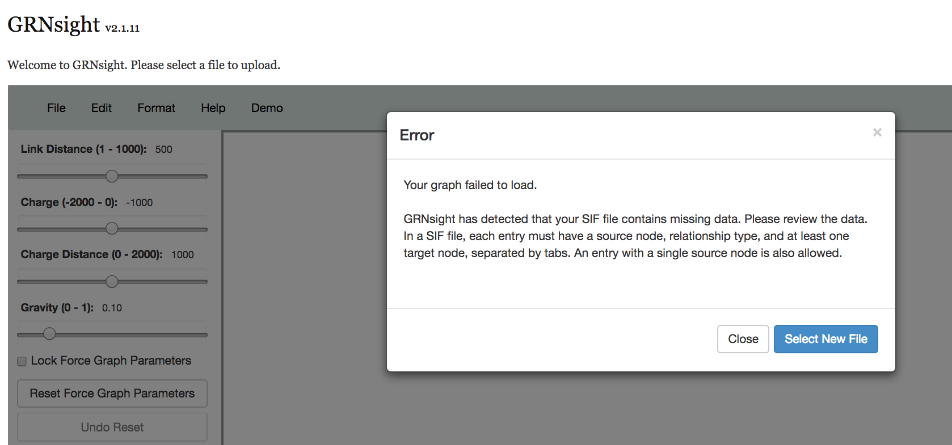
Server-side testing for SIF and GraphML file types improves quality of data interoperability
Warning or error modal will display the error to the user, with suggestions on how to fix the error.

Slide 24
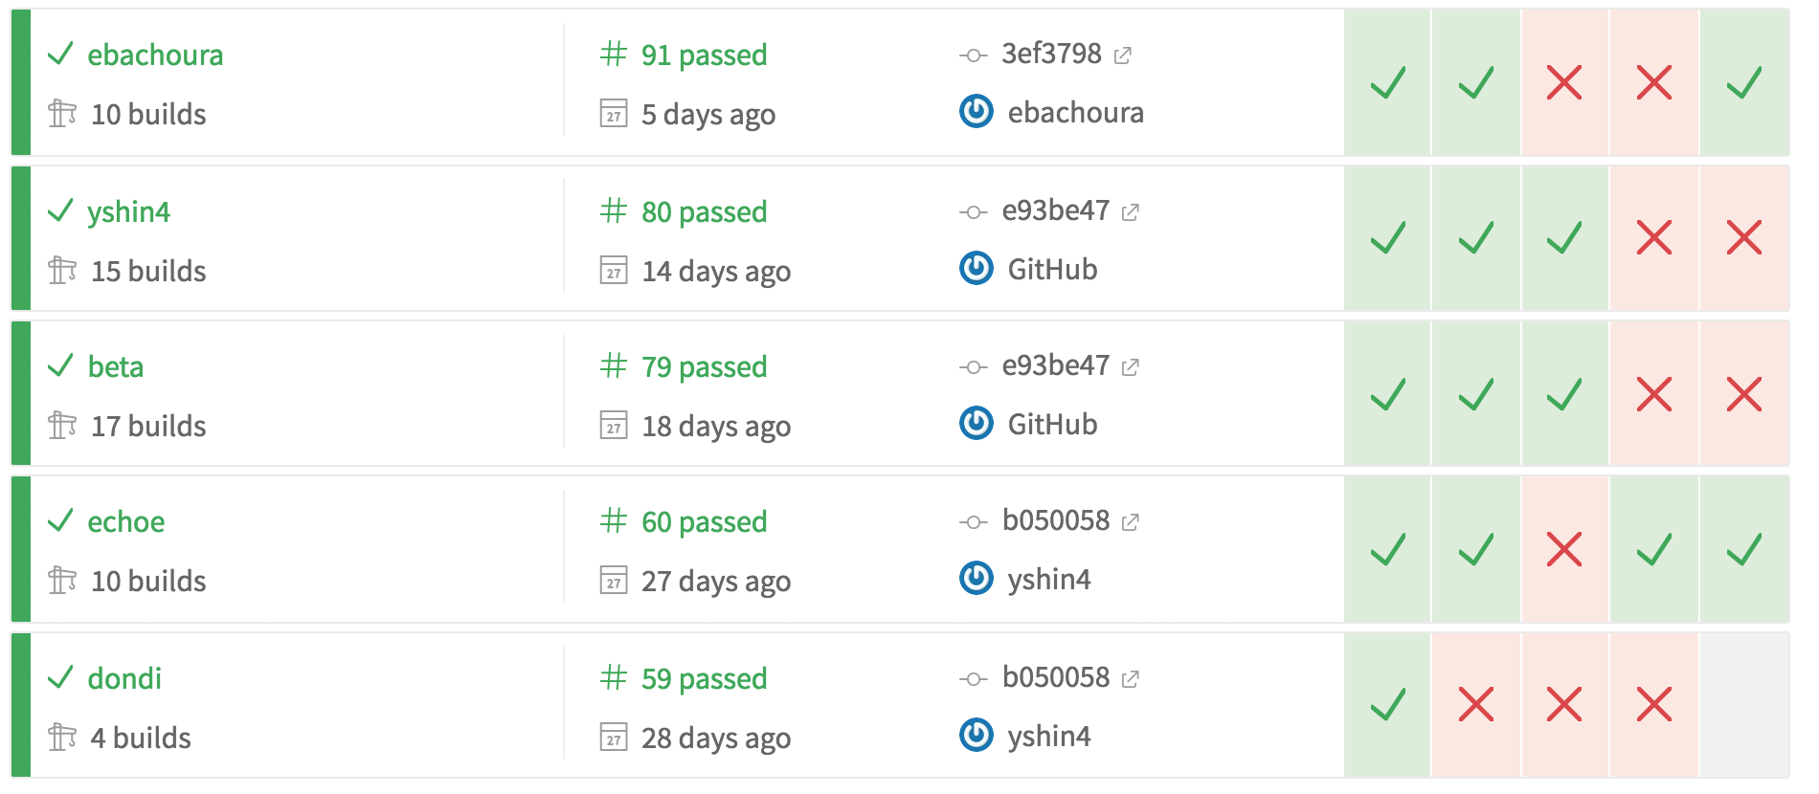
Travis Continuous Integration (C.I.) runs unit tests, code style linting, and code coverage analysis automatically
Screenshot of Travis Continuous Integration Tool

Slide 25
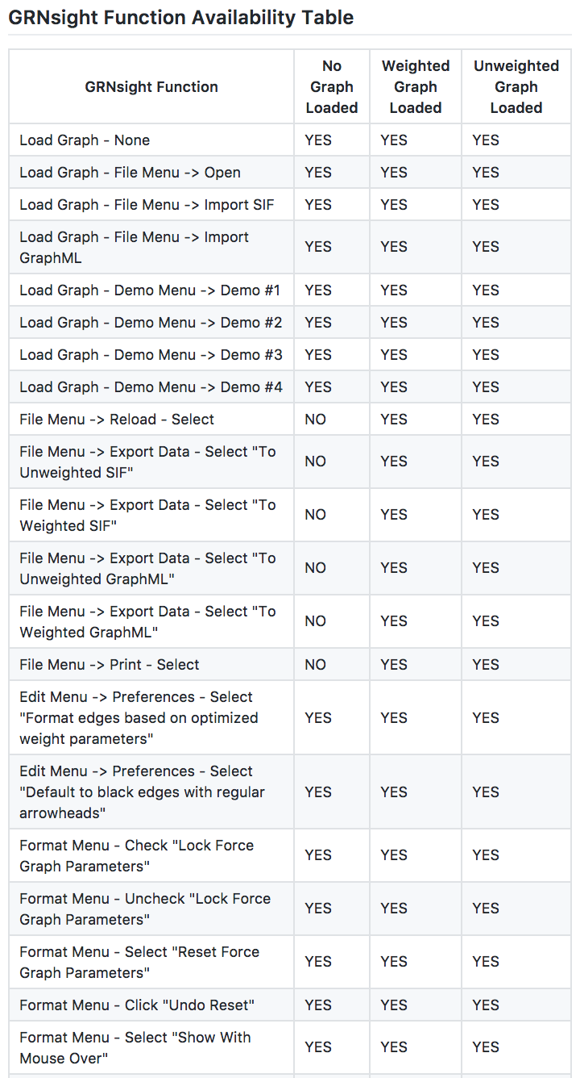
Client-side interactions are difficult to write unit tests for.
Although GRNsight has a robust testing suite, much of GRNsight’s functionality is based on the user interface, which is difficult to write unit tests for.
v2 increased number of functions user can perform.
…
Notes:
Transition: all of these things are part of testing suite, but much of GRNsight’s functionality is based on the user interface, which is very difficult to write tests for.
Addition of features in GRNsight v2 increased the number of possible combinations of functions a user can perform.

Slide 26
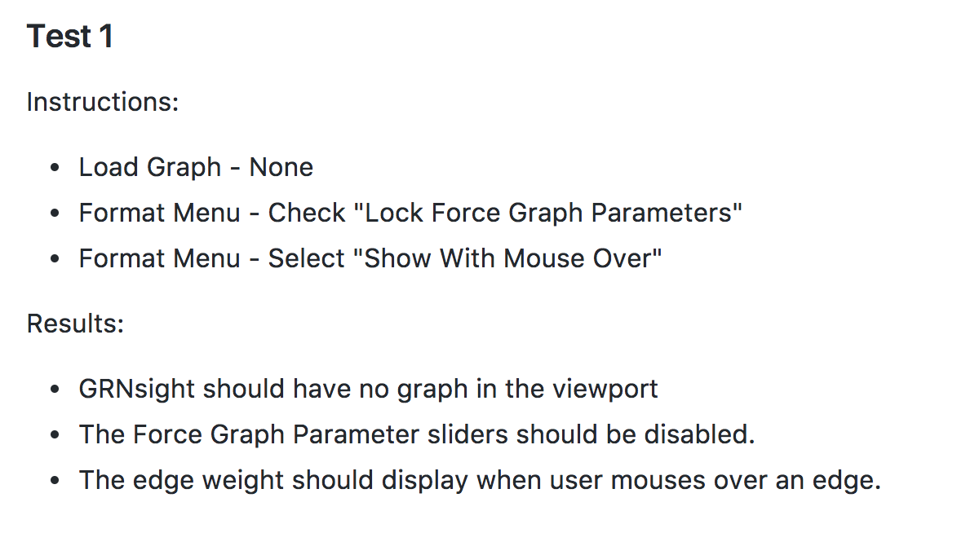
Client-side test generator produces a systematic testing manual
A user can follow the manual to systematically test combinations of user interface functions
Effective form of documentation – defines expected behavior of GRNsight in every possible state.
Notes:
Transition: all of these things are part of testing suite, but much of GRNsight’s functionality is based on the user interface, which is very difficult to write tests for.
Addition of features in GRNsight v2 increased the number of possible combinations of functions a user can perform.

Slide 27
Conclusion
Gene regulatory networks (GRNs) consist of genes, transcription factors, and the regulatory relationships between them.
GRNsight is an open source web application and service for visualizing models of gene regulatory networks.
In GRNsight version 2.0, the visual and analytic features were improved.
In GRNsight version 2.0, client and server side tests were expanded.
Notes:
In this talk, I’ve introduced you to the concept of gene regulatory networks, which consist of genes, transcription factors, and the regulatory relationships between them. We’ve developed GRNsight which is open source software which allows biologists to understand GRNs through visualization. Building from GRNsight v1, we’ve improved the visual and analytic features (three of which were highlighted in this talk), as well as expanded the client and server side tests.

Slide 28
GRNsight application and code are available under the open source BSD license
http://dondi.github.io/GRNsight/
https://github.com/dondi/GRNsight
Current and future work documented via Github Issues
Node coloring for gene expression
Alternate graph layouts

Slide 29

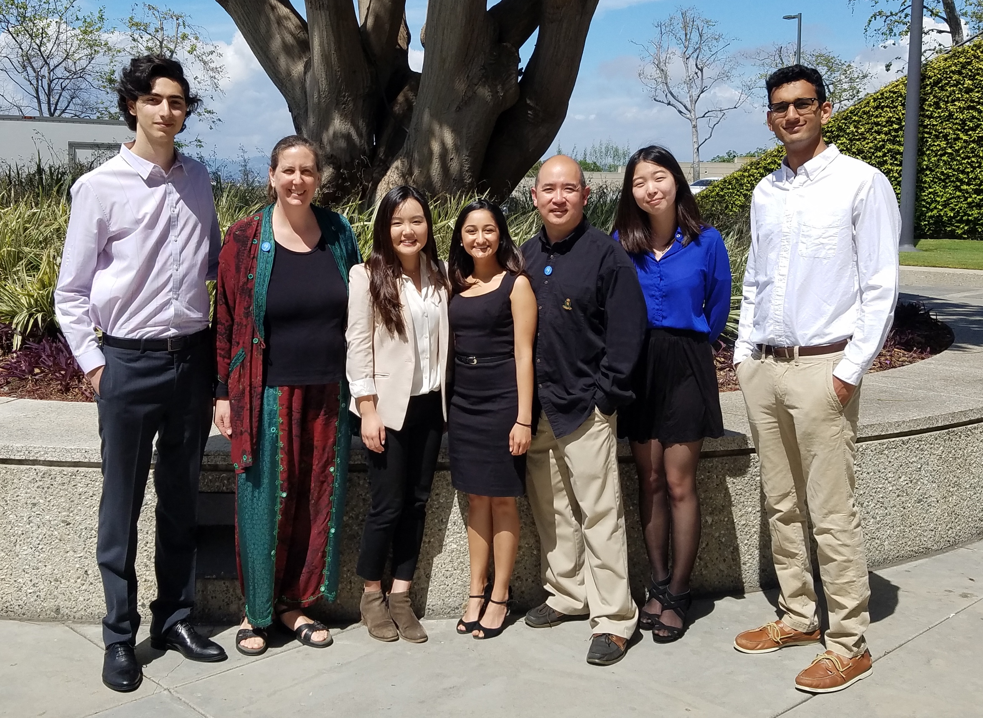
Acknowledgements
Loyola Marymount University
Dr. Kam D. Dahlquist
Dr. John David N. Dionisio
Dr. Ben G. Fitzpatrick
GRNsight Team
Mihir Samdarshi
Jen Shin
Eileen Choe
Edward Bachoura
GRNmap Team
Eddie Azinge
Maggie O’Neil
Brandon Klein
Justin Kyle Torres
Wet Lab Team
Nika Vafadari
Katherine Scheker
Nick Collins

Slide 30
Backup Slides

Slide 31
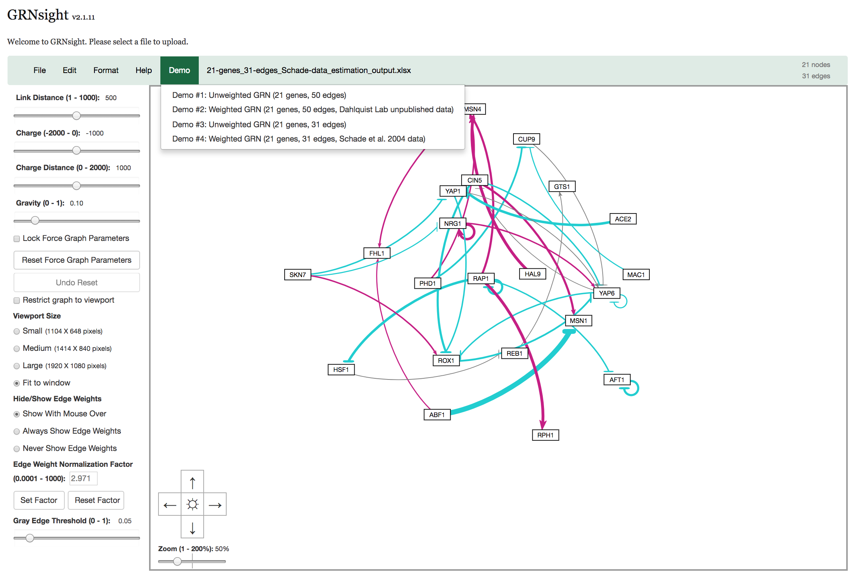
GRNsight v2.1.11 (master) Screenshot

Slide 32
Implementation of DevOps Toolchain improves productivity and efficiency
DevOps aims at automating and monitoring all steps of software construction.
Implementation of DevOps practices:
Increases frequency of deployment
Reduces failure rate of releases
Improves developer productivity and efficiency

